Slide 1
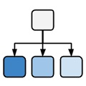
Ontologies in computational biology
Michel Dumontier, Ph.D.
Associate Professor of Medicine (Biomedical Informatics)
Stanford University
<number>
BD2K Seminar Series::Ontologies:Dumontier
Notes:
Title: Ontologies
Abstract:
Ontology has its roots as a field of philosophical study that is focused on the nature of existence. However, today's ontology (aka knowledge graph) can incorporate computable descriptions that can bring insight in a wide set of compelling applications including more precise knowledge capture, semantic data integration, sophisticated query answering, and powerful association mining - thereby delivering key value for health care and the life sciences. In this webinar, I will introduce the idea of computable ontologies and describe how they can be used with automated reasoners to perform classification, to reveal inconsistencies, and to precisely answer questions. Participants will learn about the tools of the trade to design, find, and reuse ontologies. Finally, I will discuss applications of ontologies in the fields of diagnosis and drug discovery.
Bio:
Dr. Michel Dumontier is an Associate Professor of Medicine (Biomedical Informatics) at Stanford University. His research focuses on the development of methods to integrate, mine, and make sense of large, complex, and heterogeneous biological and biomedical data. His current research interests include (1) using genetic, proteomic, and phenotypic data to find new uses for existing drugs, (2) elucidating the mechanism of single and multi-drug side effects, and (3) finding and optimizing combination drug therapies. Dr. Dumontier is the Stanford University Advisory Committee Representative for the World Wide Web Consortium, the co-Chair for the W3C Semantic Web for Health Care and the Life Sciences Interest Group, scientific advisor for the EBI-EMBL Chemistry Services Division, and the Scientific Director for Bio2RDF, an open source project to create Linked Data for the Life Sciences. He is also the founder and Editor-in-Chief for a Data Science, a new IOS Press journal featuring open access, open review, and semantic publishing.
<number>

Slide 2
Outline
Introduction: what is an ontology and where can I find them
Annotation: using ontologies for data annotation
Analysis: gaining new insights in data through ontologies
Reasoning: ontologies as formal knowledge bases
<number>
BD2K Seminar Series::Ontologies:Dumontier

Slide 3
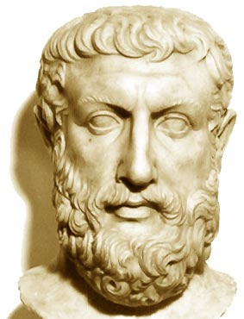
What is an ontology?
Ontology stands for a logical discourse of existence. It aims to uncover and describe the nature and structure of existence.
Predominantly the domain of philosophy known as metaphysics
Address questions such as
What does it mean to be?
What constitutes the identity of an object?
What categories of things exist?
Ontologies, when communicated to others, foster a shared understanding of things by making explicit a way to carve up the world
Greek philosopher Parmenides (515BC) proposed an ontological characterization of the fundamental nature of reality – akin to a grand unification theory
<number>
BD2K Seminar Series::Ontologies:Dumontier

Slide 4
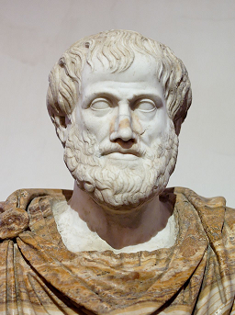
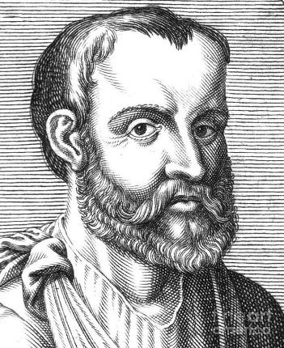
Early Bio-ontologists
Aristotle (384-322 BC)
First systematic taxonomy of biology
Classification of organisms by shared properties
Used binomial genus-differentia nomenclature
Galen (130-210 AD)
Systematic description of diseases, signs and symptoms.
In De Febrium Differentia description of fever symptoms he uses the Aristotelian genus-differentia approach
<number>
BD2K Seminar Series::Ontologies:Dumontier

Slide 5
genus–differentia definitions
are one way to specify ontologies
A type of intensional definition - where necessary and sufficient conditions are specified - composed of two parts:
genus: Serves as the basis for a new definition; all definitions with the same genus are considered members of that genus.
differentia: The portion of the definition that is not provided by the genus.
a rhombus: a quadrilateral that has bounding sides which all have the same length.
a square: a rhombus that has interior angles which are all right angles.
<number>
BD2K Seminar Series::Ontologies:Dumontier

Slide 6
Porphyry’s depiction of
Aristotle’s Categories
Supreme genus: SUBSTANCE
Differentiae: material immaterial
Subordinate genera: BODY SPIRIT
Differentiae: animate inanimate
Subordinate genera: LIVING MINERAL
Differentiae: sensitive insensitive
Proximate genera: ANIMAL PLANT
Differentiae: rational irrational
Species: HUMAN BEAST
Individuals: Socrates Plato Aristotle …
<number>
BD2K Seminar Series::Ontologies:Dumontier

Slide 7
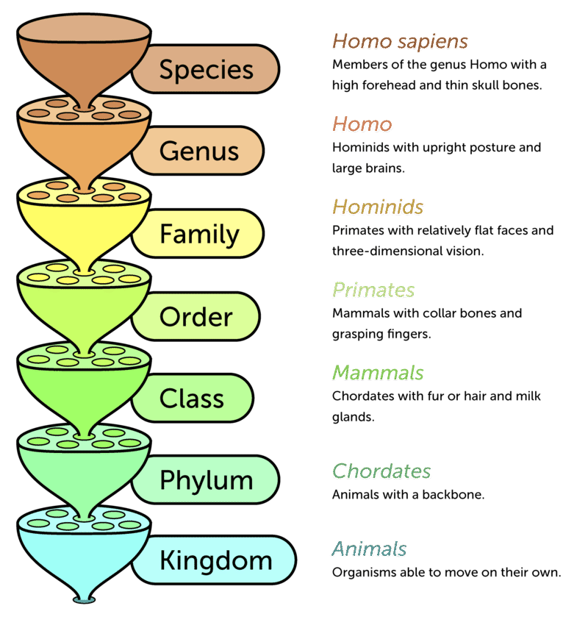
Biological Taxonomy
A biological classification (taxonomy) by Carl Linnaeus in his Systema Naturae (1735)
Three kingdoms, divided into classes, and they, in turn, into orders, families, genera, and species, with an additional rank lower than species.
Rank: a classification
Of taxonomic categories
Biological taxonomy:
an is-a hierarchy
of biological types
<number>
BD2K Seminar Series::Ontologies:Dumontier

Slide 8
Genus-differentia illustrates basic inference vis-à-vis the “is a” relationship
Mammal
Is a
Chordate
Is a
Mammal
Is a
Animal
Chordate
Animal
<number>
BD2K Seminar Series::Ontologies:Dumontier

Slide 9
Development of an increasingly
applied notion of ontology
An explicit specification of a conceptualization
- Thomas Robert Gruber, 1993 (inventor of Siri)
A conceptualization is the way we think about a domain (a “system of categories accounting for a particular view on the world”, i.e., a philosophical ontology)
A specification provides a formal way of writing it down (and making it accessible to humans and machines)
A formal speciﬁcation of a shared conceptualization
- Borst 1997
An ontology specifies a vocabulary with which to make assertions, which may be inputs or outputs of knowledge agents (such as a software program). … an ontology must be formulated in some representation language
- Gruber (2007)
An ontology is defined by axioms in a formal language with the goal to provide an unbiased (domain- and application-independent) view on reality
<number>
BD2K Seminar Series::Ontologies:Dumontier

Slide 10
How is an ontology different than a…
Folksonomy
A collection of terms (tags) to enhance categorization.
Glossary
List of terms with definitions and explanations in natural language
Controlled Vocabulary
An enumeration of terms defined to be shared and reused.
Hierarchy
A nested set of terms
Taxonomy
A hierarchy that uses the “is a” relation.
Meronomy
A hierarchy that uses the “part of” relation.
Classification
A set of categories in which objects are grouped into a hierarchy
<number>
BD2K Seminar Series::Ontologies:Dumontier
Notes:
<number>

Slide 11
Ontologies vs Classifications
Classifications focus on:
Access based on predetermined criteria (encoded by syntactic keys)
Uniform syntactic access to information
Ontologies focus on:
Meaning of terms
Nature and structure of a domain of discourse
Shared understanding

Slide 12
Ontologies vs Knowledge Bases
Knowledge bases:
Assertional component
Reflects specific states of affairs
Designed for problem solving
Terminological component (ontology)
Independent of states of affairs
Designed to support terminological services
… but are independent of the actual terminology used
Ontological formulas are invariant, necessary information

Slide 13
Why develop an ontology?
To provide a formal specification of biomedical knowledge
To provide a classification of biomedical entities
To develop a common understanding of the entities in a given domain
To enable reuse of data and knowledge, e.g., when developing a database
To enable biomedical discovery
<number>
BD2K Seminar Series::Ontologies:Dumontier
Notes:
<number>

Slide 14
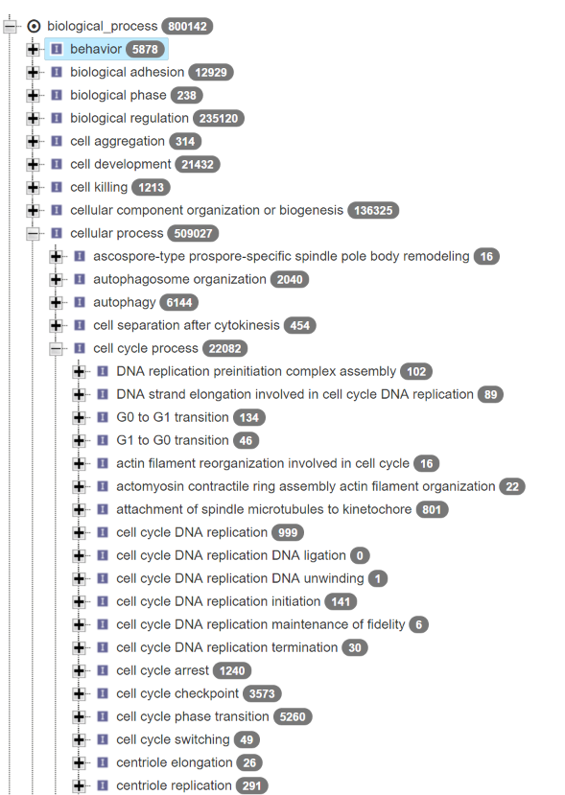

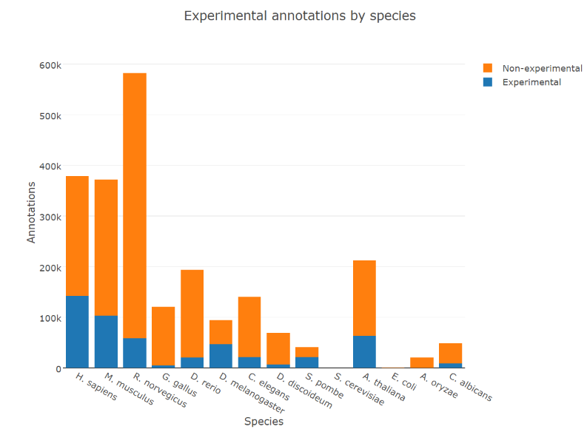
Gene Ontology
Arguably one of the most successful ontology projects in the life sciences.
Millions of annotations on hundreds of thousands of genes using GO terms.
The GO defines types used to describe gene function. It classifies functions along three aspects:
molecular function
what gene products do
cellular component
where gene products operate
biological process
The pathways and processes that gene products participate in
<number>
BD2K Seminar Series::Ontologies:Dumontier

Slide 15
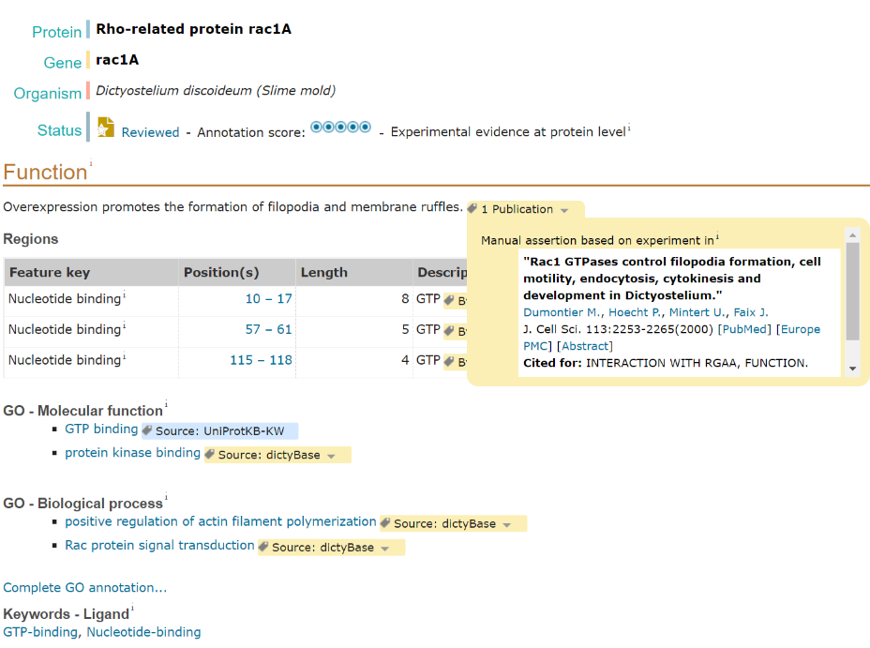
<number>
BD2K Seminar Series::Ontologies:Dumontier

Slide 16
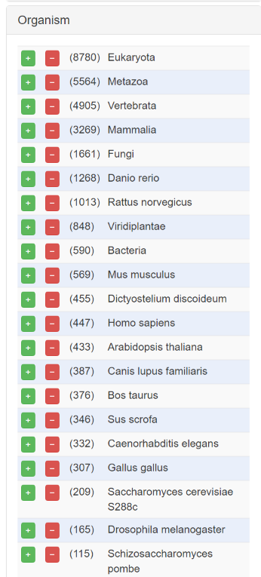
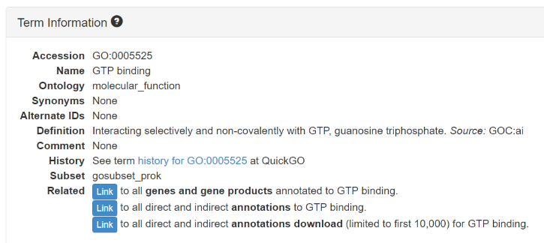
GO facilitates interoperability of function descriptions across species
<number>
BD2K Seminar Series::Ontologies:Dumontier

Slide 17
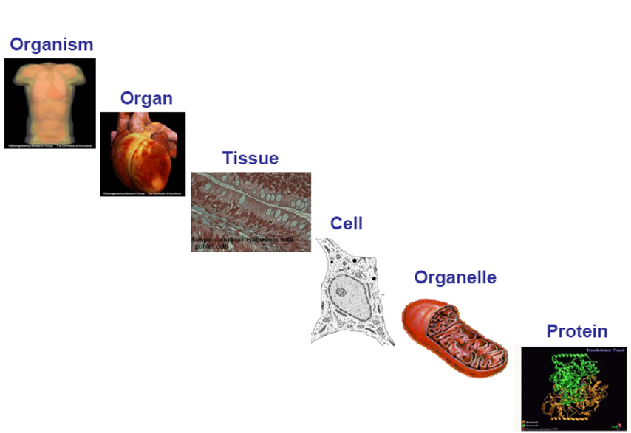
Ontologies across scales
<number>
BD2K Seminar Series::Ontologies:Dumontier
Notes:
<number>

Slide 18
some disease and phenotype ontologies
Disease Ontology (DO)
standardized ontology for human disease
Mapped to major terminologies, UMLS, MeSH, ICD10 etc.
11,280 classes
Human Phenotype Ontology ( HPO )
phenotypic features encountered in human hereditary and other disease
15,381 classes
Mammalian Phenotype Ontology (MP)
Phenotypic features encountered in animal models
12,805 classes
Experimental Factor ontology (EFO)
application ontology
Imports classes from other phenotype and related ontologies (MIREOT)
19,094 classes
Unified Medical Language System (UMLS)
US National Library of Medicine
terminology, classification and coding standards
8M normalized concepts
SNOMED-CT
clinical terminology, diseases, diagnostics and procedures
324,129 classes
NCI thesaurus
vocabulary for clinical care, translational and basic research, and public information and administrative activities.
118,941 classes
LOINC
labs, vitals signs, clinical documents
187,123 classes
ICD-10
disease, epidemiology, billing
12,450 classes
<number>
BD2K Seminar Series::Ontologies:Dumontier
Notes:
<number>

Slide 19



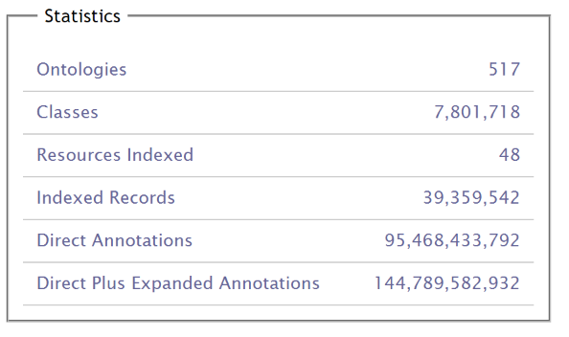
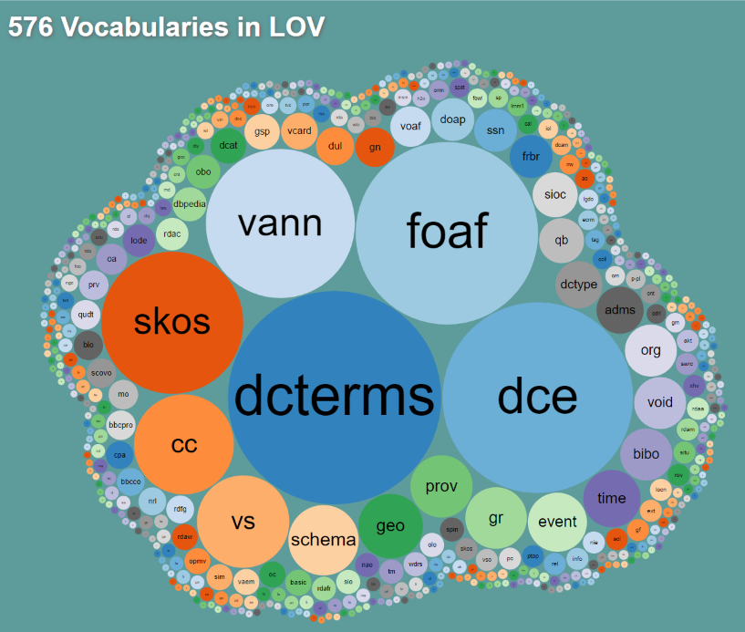
Where can we get ontologies?
<number>
BD2K Seminar Series::Ontologies:Dumontier

Slide 20
Formalization
Formalization is the process by which we map a conceptualization into a logical representation.
We logically combine the terms to form expressions, which have an unambiguous interpretation, and hence can be automatically reasoned about.
<number>
BD2K Seminar Series::Ontologies:Dumontier

Slide 21
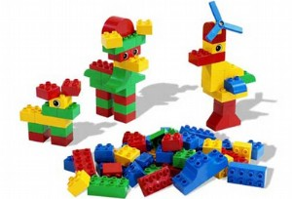
Logic-Based Ontologies
Can Be Constructed From Concept and relation Lego
<number>
BD2K Seminar Series::Ontologies:Dumontier
Notes:
<number>

Slide 22
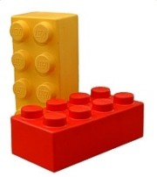
Description logics offer the building blocks
for constructing computable ontologies
‘transcription factor’
equivalentTo
‘protein’
that ‘binds to’ some DNA
and ‘regulates’ some ‘rate of transcription’
molecule ontology
function ontology
<number>
BD2K Seminar Series::Ontologies:Dumontier
Notes:
<number>

Slide 23


Have you heard of OWL?
<number>
BD2K Seminar Series::Ontologies:Dumontier
Notes:
Slick used car salesman
<number>

Slide 24
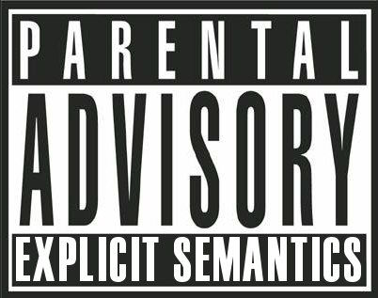
The Web Ontology Language (OWL) Has Explicit Semantics
It can be used to capture knowledge in a machine understandable way
<number>
BD2K Seminar Series::Ontologies:Dumontier
Notes:
<number>

Slide 25
OWL specifies a vocabulary and grammar to express more precisely what you mean
Enhanced vocabulary (strong axioms) to express knowledge relating to classes, properties, individuals and data values
Subclass, Equivalence
Disjointness (disjointWith (classes), differentFrom (instances))
Quantification (some, only, 0->n)
existential, universal, cardinality restriction
Negation (not)
Disjunction (or)
property characteristics
transitive, functional, inverse functional, symmetric, antisymmetric, reflexive, irreflexive
complex class expressions in domain and range restrictions
property chains
<number>
BD2K Seminar Series::Ontologies:Dumontier

Slide 26
Reasoning over OWL ontologies
Consistency: determines whether the ontology contains contradictions.
Satisfiability: determines whether classes can have instances.
Subsumption: are all instances of one class also instances of another class?
Classification: repetitive application of subsumption to discover implicit subclass links between named classes
Realization: find the most specific class that an individual belongs to.
<number>
BD2K Seminar Series::Ontologies:Dumontier

Slide 27

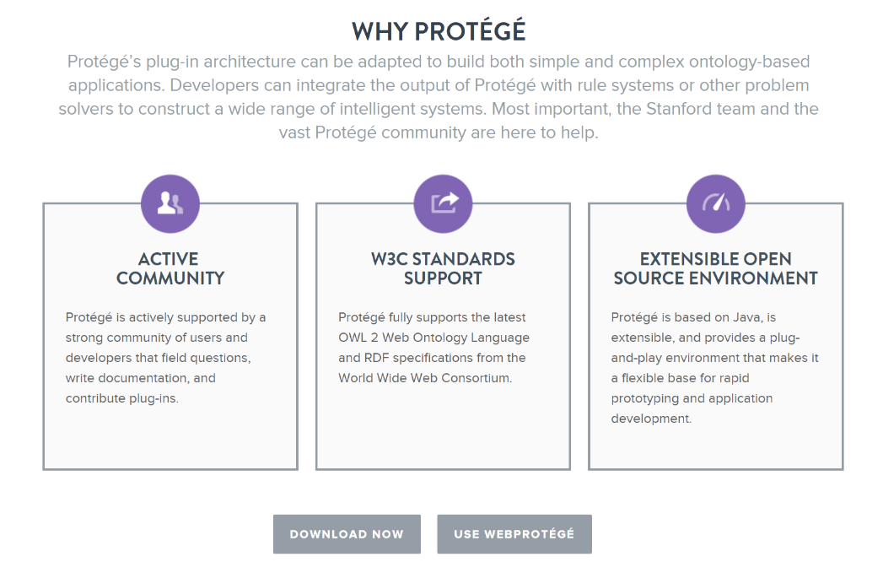

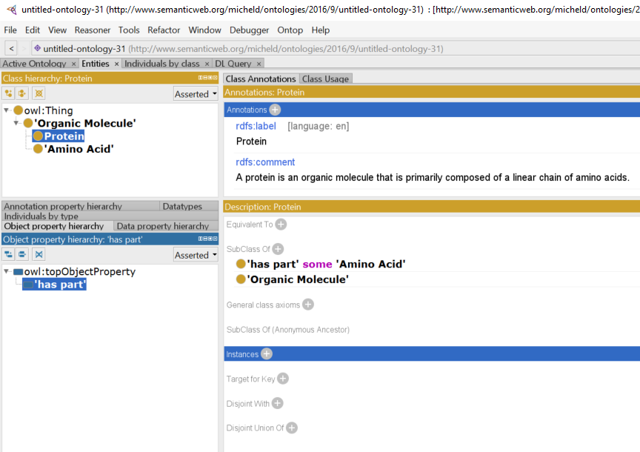
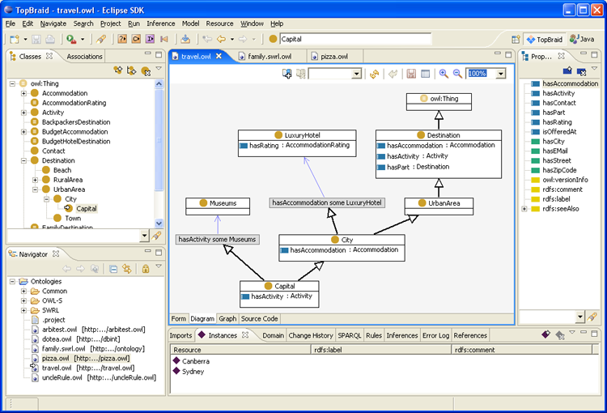
<number>
BD2K Seminar Series::Ontologies:Dumontier

Slide 28
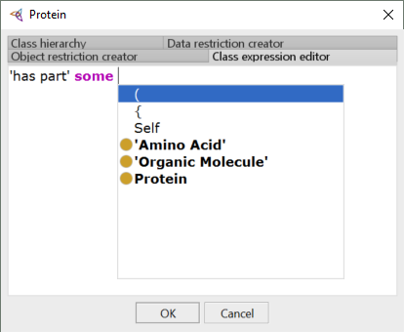
differentia
genus
<number>
BD2K Seminar Series::Ontologies:Dumontier

Slide 29
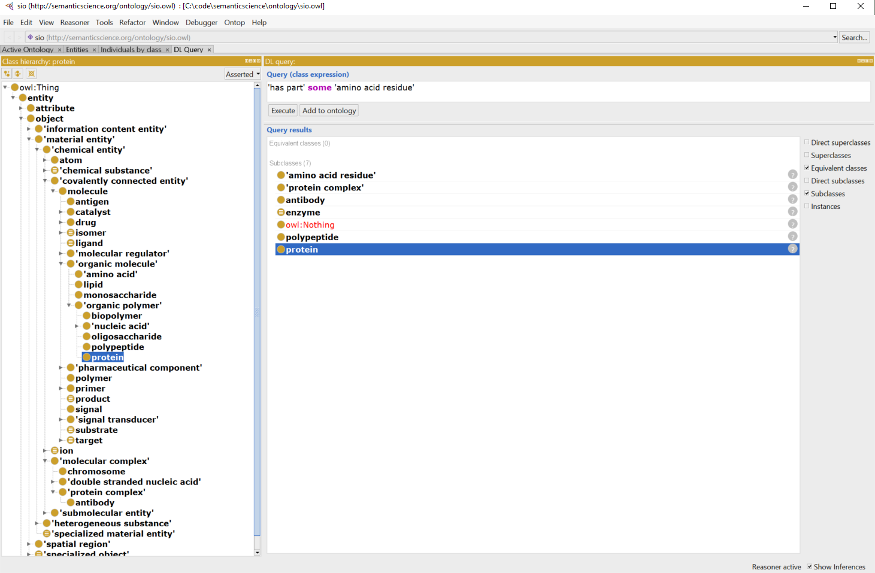
<number>
BD2K Seminar Series::Ontologies:Dumontier

Slide 30
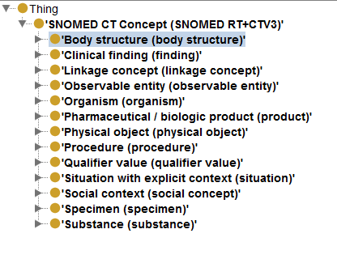
SNOMED-CT
SNOMED-CT (Clinical Terms) ontology
used in healthcare systems of more than 15 countries, including Australia, Canada, Denmark, Spain, Sweden and the UK
used by major US providers
ontology provides common vocabulary for recording clinical data
324,129 classes
<number>
BD2K Seminar Series::Ontologies:Dumontier

Slide 31
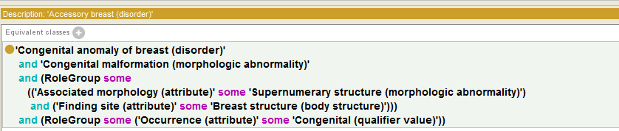
SNOMED-CT
Pattern based knowledge capture
Requires some training and an information system to implement
<number>
BD2K Seminar Series::Ontologies:Dumontier

Slide 32
SNOMED - Verification
Kaiser Permanente extended SNOMED to express, e.g.:
non-viral pneumonia (negation)
infectious pneumonia is caused by a virus or a bacterium (disjunction)
double pneumonia occurs in two lungs (cardinalities)
This is easy in SNOMED-OWL
but reasoner failed to find expected subsumptions, e.g., that bacterial pneumonia is a kind of non-viral pneumonia
Ontology under-constrained: need to add disjointness axioms
virus and bacterium must be disjoint
Adding disjointness led to surprising results
many classes become inconsistent, e.g., percutanious embolization of hepatic artery using fluoroscopy guidance
Cause of inconsistencies identified in the class groin
groin asserted to be subclass of both abdomen and leg
abdomen and leg are disjoint
modelling of groin (and other similar “junction” regions) identified as incorrect
<number>
BD2K Seminar Series::Ontologies:Dumontier

Slide 33
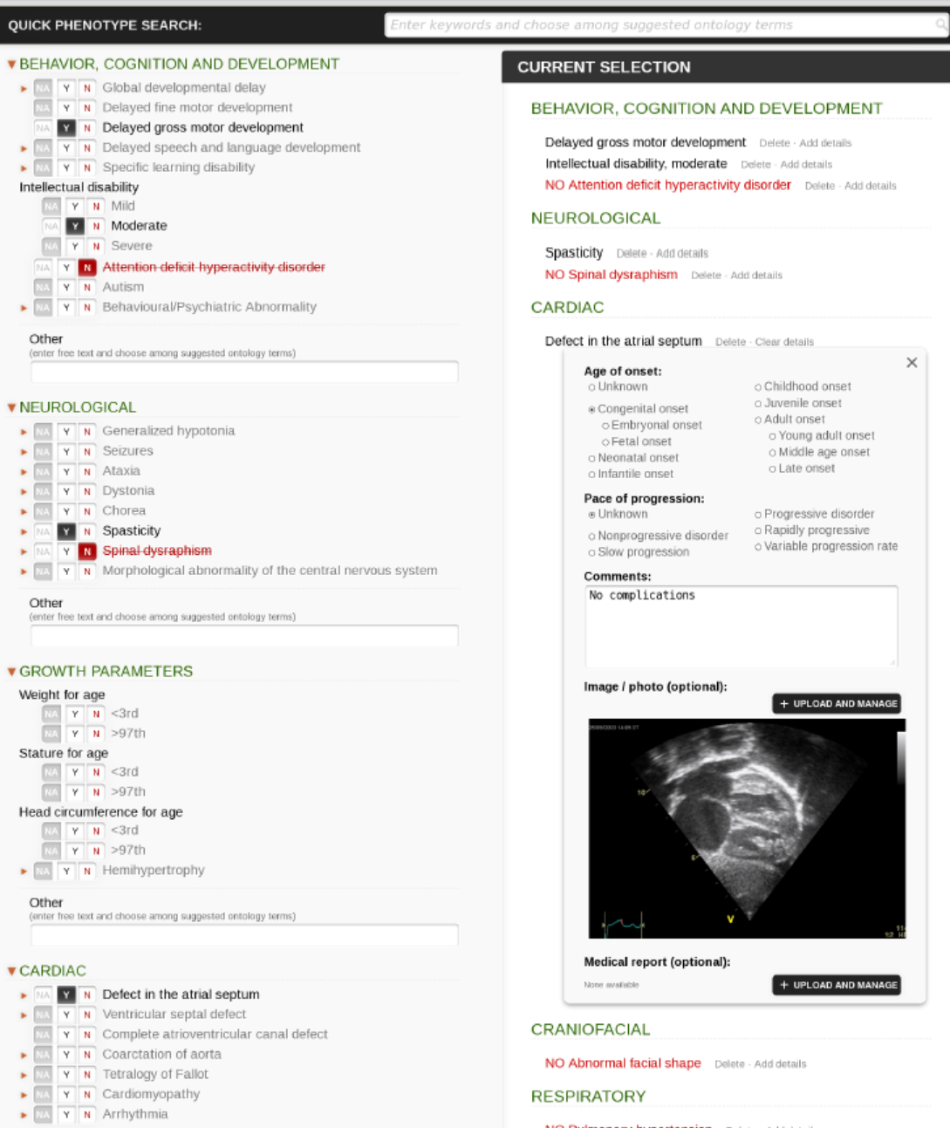
Phenotips
Using controlled vocabulary (human phenotype ontology) for phenotyping
Can collect demographics, medical history, family history, labs, findings
Girdea et al. (2013). Hum. Mutat., 34: 1057–1065. doi: 10.1002/humu.22347
<number>
BD2K Seminar Series::Ontologies:Dumontier

Slide 34
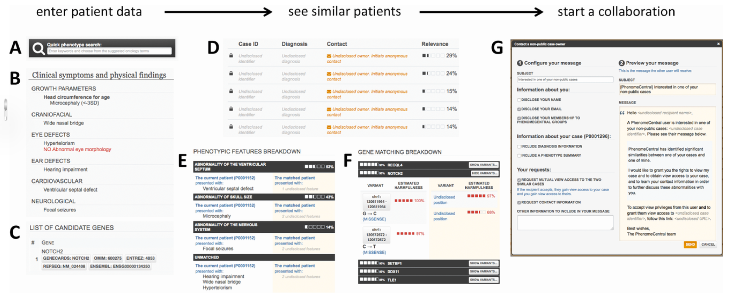
PhenomeCentral: A Portal for Phenotypic and Genotypic Matchmaking of Patients with Rare Genetic Diseases
Human Mutation
Volume 36, Issue 10, pages 931-940, 31 AUG 2015 DOI: 10.1002/humu.22851
http://onlinelibrary.wiley.com/doi/10.1002/humu.22851/full#humu22851-fig-0001
<number>
BD2K Seminar Series::Ontologies:Dumontier
Notes:
<number>
Finding similar patients in PhenomeCentral. Patient data can be contributed to PhenomeCentral through the PhenoTips user interface, including the phenotype quick search box that enables rapid entry of phenotype terms from the HPO (A), or selected records can be automatically deidentified and transferred from any PhenoTips instance automatically. The patient record can contain both present and absent phenotypic features (B) as well as genetic information, including candidate genes and VCF files (C). The patient's features are then immediately compared with all other patients in PhenomeCentral (D), and the best matches are shown to the user. A detailed breakdown of the phenotypic (E) and genotypic (F) similarity is shown for each match, enabling the user to see the underlying reasons for the match and determine whether or not the match is worth following up. A customizable email template (G) facilitates contacting the (potentially undisclosed) submitter of another patient record.
IF THIS IMAGE HAS BEEN PROVIDED BY OR IS OWNED BY A THIRD PARTY, AS INDICATED IN THE CAPTION LINE, THEN FURTHER PERMISSION MAY BE NEEDED BEFORE ANY FURTHER USE. PLEASE CONTACT WILEY'S PERMISSIONS DEPARTMENT ON PERMISSIONS@WILEY.COM OR USE THE RIGHTSLINK SERVICE BY CLICKING ON THE 'REQUEST PERMISSIONS' LINK ACCOMPANYING THIS ARTICLE. WILEY OR AUTHOR OWNED IMAGES MAY BE USED FOR NON-COMMERCIAL PURPOSES, SUBJECT TO PROPER CITATION OF THE ARTICLE, AUTHOR, AND PUBLISHER.

Slide 35

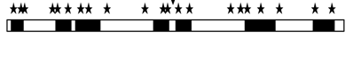
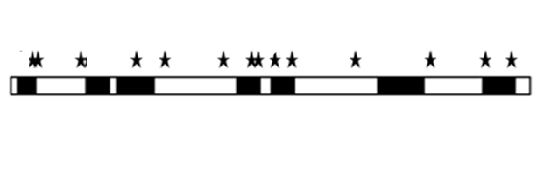

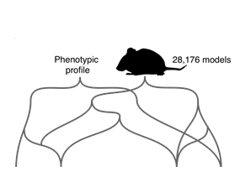

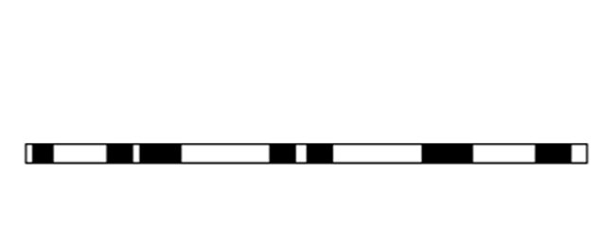
Ontology-Aided Rare Disease Diagnosis
Remove off-target, common variants, and variants not in known disease causing genes
Compare phenotype profiles from:
Clinvar, OMIM, Orphanet
Credit: Damian Smedley & Will Bone
http://compbio.charite.de/PhenIX/
Zemojtel et al. Sci Transl Med. 2014. 6(252):252ra123
<number>
BD2K Seminar Series::Ontologies:Dumontier
Notes:
<number>

Slide 36
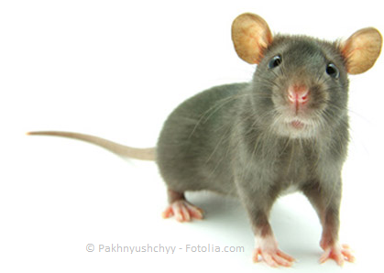
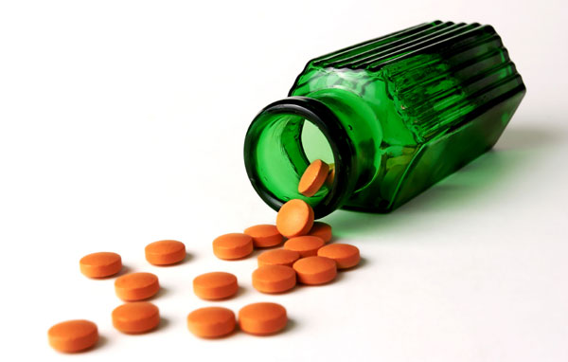
Identifying drug targets
from mouse knock-out phenotypes
Main idea: we compare the phenotypes of knockout mouse models with the effects of drugs. When similar, we hypothesize that the drug acts as an inhibitor of the gene, thereby mimicking its phenotypic effect.
similar
phenotypes
effects
non-functional
gene model
drug
inhibits
ortholog
gene
human gene
<number>
BD2K Seminar Series::Ontologies:Dumontier

Slide 37


We use mappings to establish equivalences between human and mammalian phenotype ontologies
Mouse Phenotypes
Mammalian Phenotype Ontology
PhenomeNet
PhenomeDrug
Drug effects
(mappings from UMLS to DO, NBO, MP)
BD2K Seminar Series::Ontologies:Dumontier
Notes:
8)
The PhenomeNet network utilizes semantic similarity.
Semantic similarity is a measure of how similar two entities are to one another.
Let’s consider two bags of terms. We have a green bag and a blue bag. Questions we could ask could be are their contents related? If they are similar, maybe we can make use of this relation or commonalities between the two bags. This can be done by calculating the similarity between two sets (or bags).
Similarity can be calculated in different ways. In this case we will use the jaccard index weighted by information content as it is a means of calculating similarity between two sets of data.
What is calculated is a similarity score for each possible pairing between the terms of bag 1 with bag 2. The pairings can be ranked so that the most similar pairs can be found at the top, and most dissimilar pairs at the bottom. A maximized pairing would have a similarity score approaching 1, and a dissimilar score approaching 0.

Slide 38
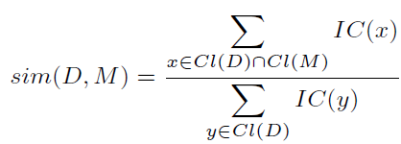
We use measures of semantic similarity to compare drugs to models
Given a drug effect profile D and a mouse model M, we compute the semantic similarity as an information weighted Jaccard metric.
The similarity measure used is non-symmetrical and determines the amount of information about a drug effect profile D that is covered by a set of mouse model phenotypes M.
<number>
BD2K Seminar Series::Ontologies:Dumontier
Notes:
<number>

Slide 39
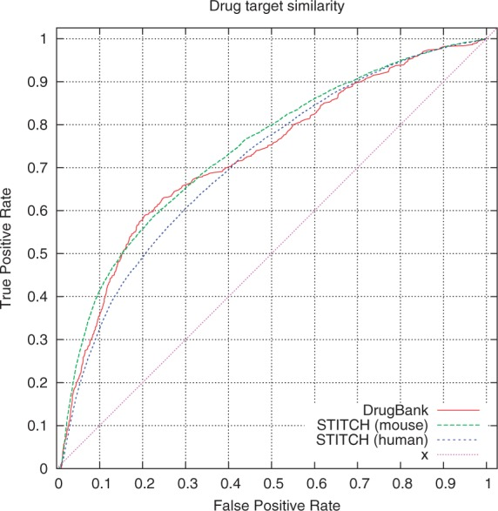
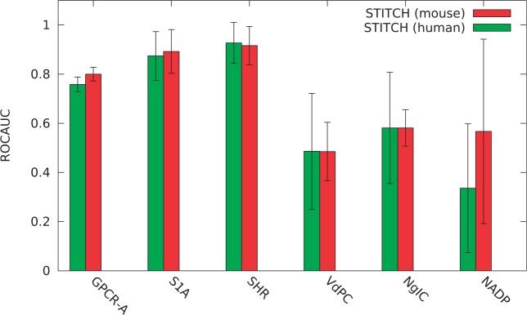
We find that phenotypic information alone can recover known drug targets
(and predict new ones)
14,682 drugs; 7,255 mouse genotypes
Validation against known and predicted inhibitor-target pairs
0.82 ROC AUC for mouse targets (STITCH)
0.76 ROC AUC for human targets (STITCH)
0.72 ROC AUC for human targets (DrugBank)
<number>
BD2K Seminar Series::Ontologies:Dumontier
Notes:
<number>

Slide 40
Loss of function models
provide information about the targets of inhibitor drugs
Diclofenac
NSAID used to treat pain, osteoarthritis and rheumatoid arthritis
46% drug effects explained by COX-2 knockout
inflammation, gastritis, constipation, upper GI tract pain
49% drug effects explained by PPARg knockout
peroxisome proliferator activated receptor gamma (PPARg) regulates metabolism, proliferation, inflammation and differentiation,
Bioinformatics, 2013. doi:10.1093/bioinformatics/btt613
BD2K Seminar Series::Ontologies:Dumontier

Slide 41
Summary
Ontologies have a rich history in philosophy that has evolved to modular and computable representation of human knowledge
Description logics (e.g. OWL) are the current favored formalism to build and test ontologies.
Ontologies have a variety of uses from the answering questions to enabling sophisticated knowledge discovery.
<number>
BD2K Seminar Series::Ontologies:Dumontier

Slide 42
Acknowledgements
Slides shamelessly stolen and adapted from true leaders in the field:
Mark Musen
Barry Smith
Ian Horrocks
Robert Hoehndorf
Melissa Haendel
Paul Schofield
<number>
BD2K Seminar Series::Ontologies:Dumontier

Slide 43

dumontierlab.com
michel.dumontier@stanford.edu
Website: http://dumontierlab.com
<number>
BD2K Seminar Series::Ontologies:Dumontier
Notes:
<number>

